Slide 1
Oracle certified Java associate
Lesson 13
Andrei Dragutan

Slide 2
3 părți
Teorie: inheritance
Arrays
Practica: homework & questions

Slide 3
Arrays
what is an array
how to declare/instantiate/use
one-dimensional array
multidimensional array

Slide 4

Array
Definition: an array is an object that stores collection of values.
An array can store 2 types of data:
primitive data
objects

Slide 5
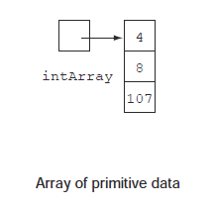
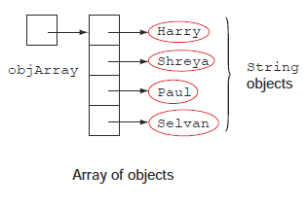
Array: why?
Convenience: Declare one single container for multiple variables of the same type
Performance: the members of an array are defined in continous memory location.
Both array of primitives & array of objects are stored in the Heap

Slide 6

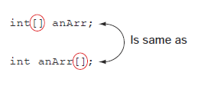
Array: declaration
The array is declared as follows:
(access modifier if necessary) type[] nameOfArray;
The number of bracker pairs indicates the depth of array nesting:
one-dimensional array
two-dimensional array
...
Java does not set the limit on the depth of an array.
square brackets can be placed after the type or after the name of the array

Slide 7
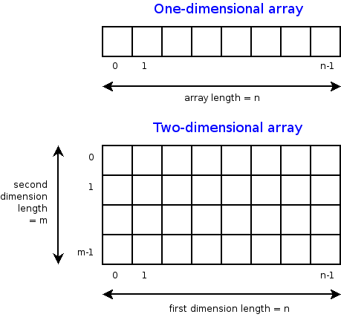
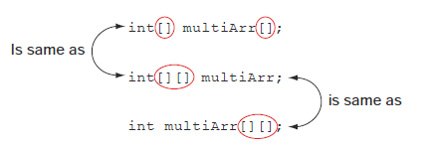
Array: multidimensional vs one-dimensional
One dimensional array:
int[] arr;
2-dimensional array:
int[][] multiArr;
imagini: faculty.ycp.edu
OCA Java SE 8 Programmer I Certification Guide

Slide 8
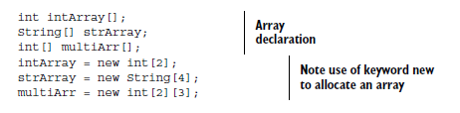
Array: allocation
Once the array is declared as follows:
(access modifier if necessary) type[] nameOfArray;
The array should be allocated:
you should indicate the size of the array

Slide 9

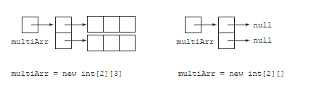
Array: allocation of multi-dimensional arrays
** Once allocated, the elements of the array are initialized to the default values:
0, 0.0, false, ‘\u0000’

Slide 10


Array: invalid allocation

Slide 11
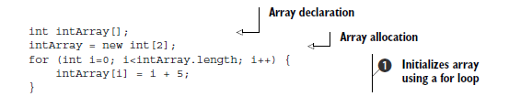

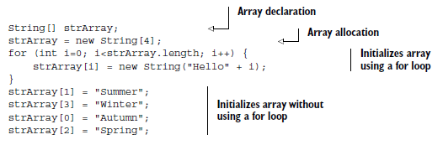
Array: initialization

Slide 12
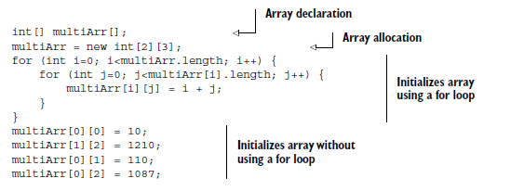
Array: initialization of multi-dimensional

Slide 13



Array: combining declaration, allocation & initialization
won’t compile

Slide 14
Array: members
Every array is an object
Public members:
length - returns the size of the array
clone() - returns the copy of the array which this method is called on.
inherited methods from Object
the index of the array starts from 0:
first element has index 0

Slide 15
Inheritance:
What is Inheritance
Agregation and Composition
Method Overriding

Slide 16
OOP principles
Inheritance
Polymorphism
Abstraction
Encapsulation

Slide 17
Inheritance (IS-A)
Inheritance in java is a mechanism in which one class acquires all the properties and behaviors of parent class. It is an important part of OPPs(Object Oriented programming system).
The idea behind inheritance in java is that you can create new classes that are built upon existing classes. When you inherit from an existing class, you can reuse methods and fields of parent class, and you can add new methods and fields also.

Slide 18
Why use inheritance in java
For Method Overriding (so runtime polymorphism can be achieved).
For Code Reusability.

Slide 19
Terms used in Inheritence
Class: A class is a group of objects which have common properties. It is a template or blueprint from which objects are created.
Sub Class/Child Class: Subclass is a class which inherits the other class. It is also called a derived class, extended class, or child class.
Super Class/Parent Class: Superclass is the class from where a subclass inherits the features. It is also called a base class or a parent class.
Reusability: As the name specifies, reusability is a mechanism which facilitates you to reuse the fields and methods of the existing class when you create a new class. You can use the same fields and methods already defined in previous class.

Slide 20
Syntax of Java Inheritance
class Subclass-name extends Superclass-name
{
//methods and fields
}
The extends keyword indicates that you are making a new class that derives from an existing class. The meaning of "extends" is to increase the functionality.

Slide 21
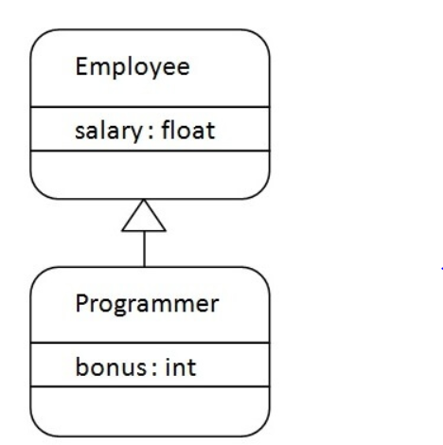
Java Inheritance Example

Slide 22
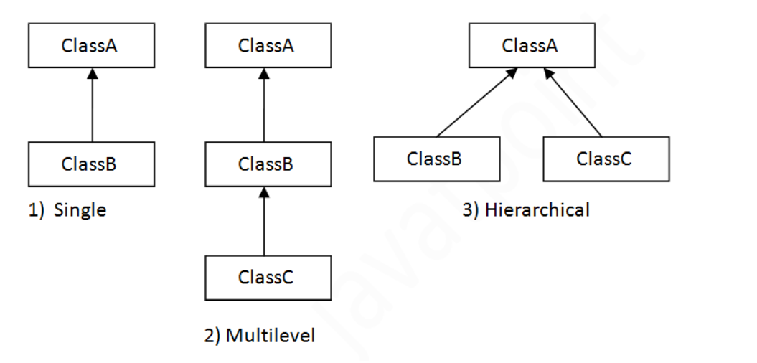
Type of Inheritamce in Java
Note: Multiple inheritance is not supported in java through class.

Slide 23
Agregation/Composition (HAS-A)
If a class have an entity reference, it is known as Aggregation or Composition.
Aggregation implies a relationship where the child can exist independently of the parent. Example: Class (parent) and Student (child). Delete the Parent and the Students still exist.
Composition implies a relationship where the child cannot exist independent of the parent. Example: House (parent) and Room (child). Rooms don't exist separate to a House.

Slide 24
When to use Agregation/Composition
Code reuse is also best achieved by aggregation when there is no is-a relationship but a has-a
Inheritance should be used only if the relationship is-a is maintained throughout the lifetime of the objects involved; otherwise, aggregation is the best choice.

Slide 25
Method Overriding
If subclass (child class) has the same method as declared in the parent class, it is known as method overriding in java.
In other words, If subclass provides the specific implementation of the method that has been provided by one of its parent class, it is known as method overriding.

Slide 26
Rules for Overriding
method must have same name as in the parent class
method must have same parameter as in the parent class.
must be IS-A relationship (inheritance).

Slide 27
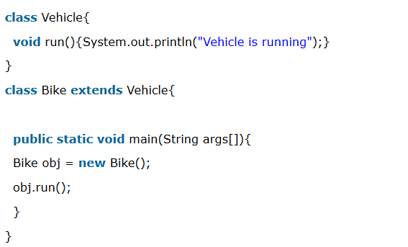
Understanding the problem without method overriding

Slide 28
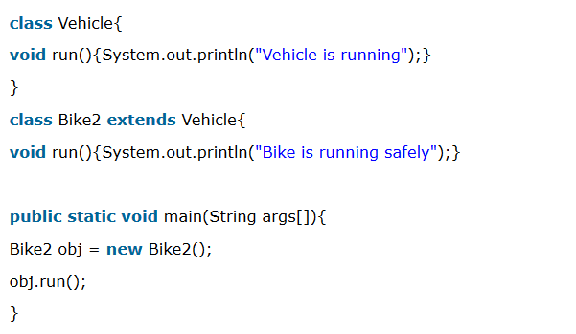
Understanding the problem without method overriding

Slide 29
Practice:
Homework
Test simulation

Slide 30
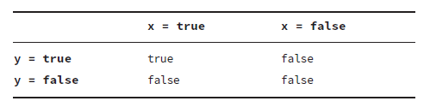
Given the following truth table, which operator for the boolean expressions x and y corresponds to this relationship?
A. --
B. ++
C. ||
D. &&
Notes:
D. The question is about boolean operators. Since Options A and B are numeric operators, they can be instantly disregarded.
The question then simplifies to which boolean expression, && or ||, corresponds to the truth table that only evaluates to true if both operands are true. Only the conjunctive logical && operator represents this relationship, making
Option D the correct answer.

Slide 31
What is the output of the following code snippet?
int hops = 0;
int jumps = 0;
jumps = hops++;
if(jumps)
System.out.print("Jump!");
else
System.out.print("Hop!");
A. Jump!
B. Hop!
C. The code does not compile.
D. The code compiles but throws an exception at runtime.
Notes:
C. The value of jumps and hops is unimportant because this code does not compile, making
Option C the correct answer. Unlike some other programming languages, Java does not
automatically convert integers to boolean values for use in if-then statements. The statement
if(jumps) evaluates to if(0), and since 0 is not a boolean value, the code does not
compile. Note that the value of the jumps variable is irrelevant in this example; no integer
evaluates to a boolean value in Java.

Slide 32
Given the following code snippet, assuming dayOfWeek is an int, what variable type of saturday is not permitted?
final ________ saturday = 6;
switch(dayOfWeek) {
default:
System.out.print("Another Weekday");
break;
case saturday:
System.out.print("Weekend!");
}
A. byte
B. long
C. int
D. None of the above
Notes:
B. Any value that can be implicitly promoted to int will work for the case statement with
an int input. Since switch statements do not support long values, and long cannot be
converted to int without a possible loss of data, Option B is the correct answer.

Slide 33
What will be the output
package schedule;
public class PrintWeek {
public static final void main(String[] days) {
System.out.print(5 + 6 + "7" + 8 + 9);
}
}
A. 56789
B. 11789
C. 11717
D. The code does not compile.
Notes:
B. Remember that Java evaluates + from left to right. The first two values are both numbers,
so the + is evaluated as numeric addition, resulting in a reduction to 11 + "7" + 8
+ 9. The next two terms, 11 + "7", are handled as string concatenation since one of the
terms is a String. This allows us to reduce the expression to "117" + 8 + 9. Likewise, the
final two terms are each evaluated one at a time with the String on the left. Therefore, the
final value is 11789, making Option B the correct answer.

Slide 34
Fill in the blanks:
Given two non-null String objects with reference names apples and
oranges, if apples ______ oranges evaluates to true, then apples ______
oranges must also evaluate to true.
A. ==, equals()
B. !=, equals()
C. equals(), ==
D. equals(), =!
Notes:
A. For this question, remember that if two String objects evaluate to true using ==, then
they are the same object. If they are the same String object, equals() will trivially return
true. Option A correctly reflects this principle. Option B is incorrect as two String
objects that are not the same may still be equivalent in terms of equals(). For example,
apples == new String(apples) evaluates to false, but equals() will evaluate to true
on these String objects. Likewise, Options C and D are also incorrect because two String
objects that are equivalent in terms of equals() may be different objects.

Slide 35
Which of the following are primitives?
int[] lowercase = new int[0];
Integer[] uppercase = new Integer[0];
A. Only lowercase
B. Only uppercase
C. Bother lowercase and uppercase
D. Neither lowercase nor uppercase
Notes:
D. Trick question! While int is a primitive, all arrays are objects. One way to tell is that an array has a public instance variable called length. Another way is that you can assign it a variable of type Object. Therefore, Option D is correct.

Slide 36
How many of the following are legal declarations?
[]double lion;
double[] tiger;
double bear[];
A. None
B. One
C. Two
D. Three
Notes:
C. The array braces are allowed to appear before or after the variable name, making the
tiger and bear declarations correct. The braces are not allowed to appear before the type
making the lion declaration incorrect. Therefore, Option C is correct.

Slide 37
Which of the following create an empty two-dimensional array with dimensions 2×2?
A. int[][] blue = new int[2, 2];
B. int[][] blue = new int[2], [2];
C. int[][] blue = new int[2][2];
D. int[][] blue = new int[2 x 2];
Notes:
C. A two-dimensional array is declared by listing both sizes in separate pairs of braces.
Option C correctly shows this syntax.

Slide 38
How many of the following are legal declarations?
float[] lion = new float[];
float[] tiger = new float[1];
float[] bear = new[] float;
float[] ohMy = new[1] float;
A. None
B. One
C. Two
D. Three
Notes:
B. Since no elements are being provided when creating the arrays, a size is required. Therefore,
lion and bear are incorrect. The braces containing the size are required to be after
the type, making ohMy incorrect. The only one that is correct is tiger, making the correct
answer Option B.

Slide 39
Întrebări, sugestii, propuneri

